Slide 1
Sales Metric Dashboard Analysis
Created by Prachi PALIWAL

Slide 2
Overview
Dataset link -: https://github.com/Prachi005748/CODINGSAMURAI/blob/main/Project%201/Sales_Data_2024.xlsx
Data Cleaning: Data cleaning for the Sales Dataset is essential and involves removing duplicates, fixing spelling errors, handling empty rows, standardizing date formats in the "Order Date" column, and ensuring a uniform monetary format in the "Sales" column. This process ensures data accuracy and integrity, making the dataset suitable for analysis.

Slide 3
aNALYSIS

Slide 4
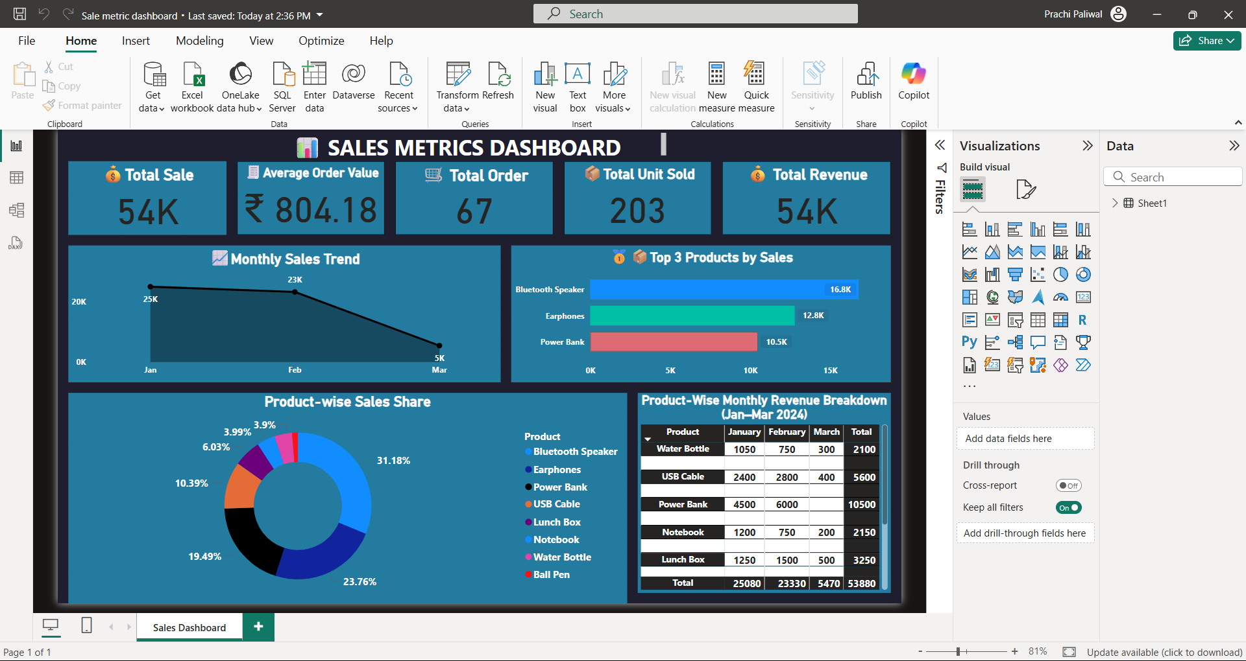
Analysis:
Total Sale: ₹54K worth of sales were made during the analysis period.
Average Order Value: Each order generated an average of ₹804.18 revenue.
Total Orders: 67 customer orders were successfully processed.
Total Units Sold: A total of 203 units were sold across all products.
Total Revenue: The business earned ₹54K in total revenue.

Slide 5

Monthly Sales Trend:
January recorded the highest sales with ₹25K revenue.
February saw a slight dip, generating ₹23K.
March experienced a sharp decline, with only ₹5K in sales.
Overall, there is a downward trend across the three months.

Slide 6

Top 3 product by sales:
Bluetooth Speaker generated the highest sales with ₹16.8K.
Power Bank stood third with ₹10.5K in sales.
Earphones followed with a total of ₹12.8K revenue.

Slide 7
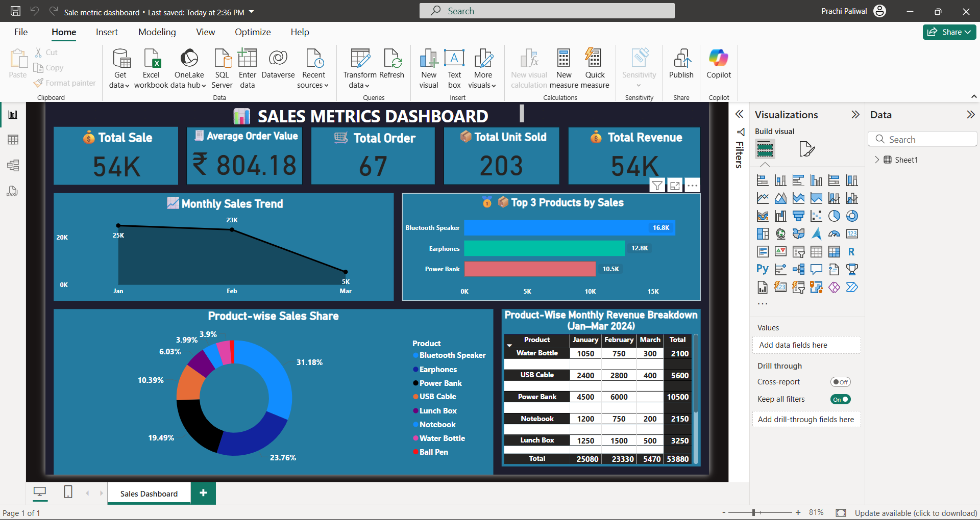
Product – wise sales share:
Bluetooth Speaker held the largest share at 31.18% of total sales.
Earphones contributed 23.76%, securing the second spot.
Power Bank accounted for 19.49% of the sales share.
Top 3 products together made up over 74% of total revenue.

Slide 8
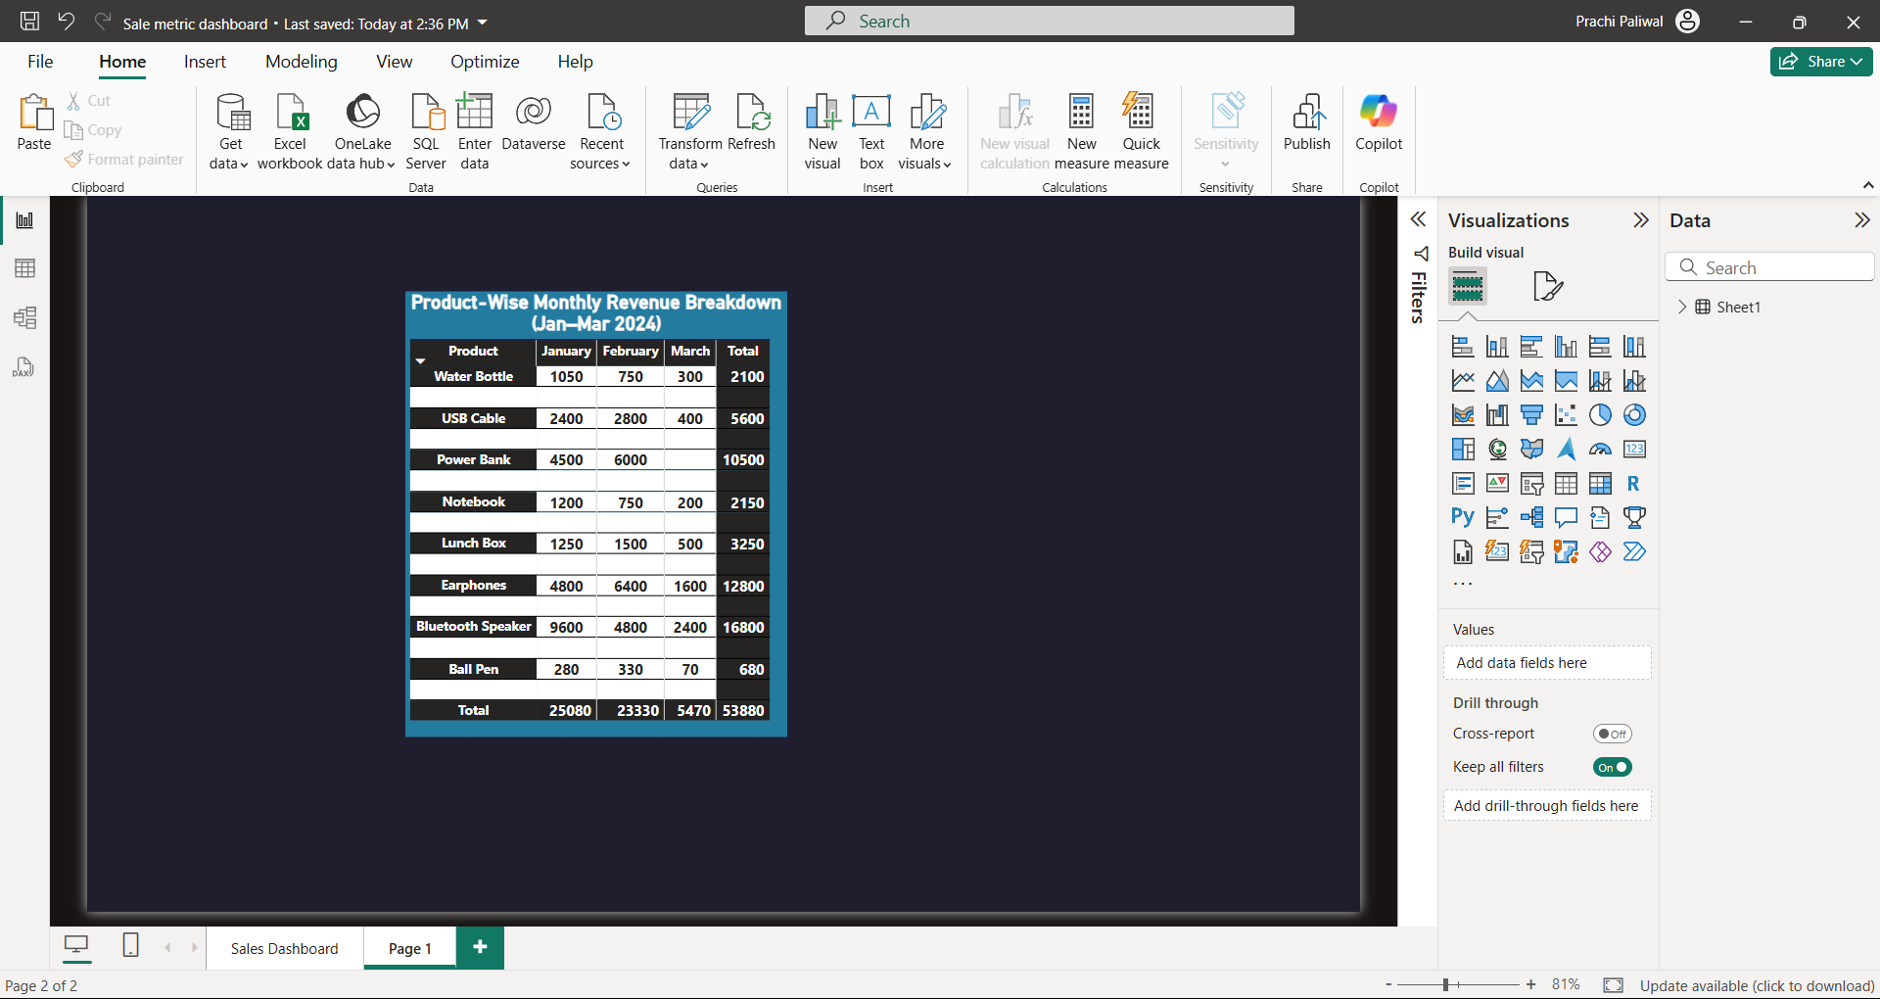
Product-Wise Monthly Revenue Breakdown (Jan–Mar 2024):
Power Bank had the highest February revenue with ₹6,000.
Earphones maintained consistent sales across all three months.
Bluetooth Speaker showed strong performance in Jan & Feb, slight dip in March.
March sales declined for almost all products, indicating a possible seasonal drop.

